Slide 1
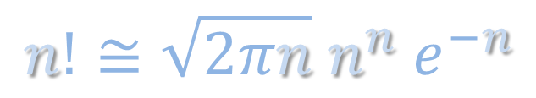


Stirling’s approximation
$$n!≅\sqrt{2πn} n^{n} e^{−n}$$
$$\ln\left(x\right)$$
2.5
2.0
1.5
1.0
0.5
0.0
$$x$$
1
2
3
4
5
n - 1
n
n + 1

Slide 2


Stirling’s approximation
$$\ln\left( n! \right)=\ln\left[ n \left(n−1\right) \left(n−2\right) ⋯3 ∙2 ∙1 \right]$$
0
$$=\ln\left(n\right)∙1+\ln\left(n−1\right)∙1+\ln\left(n−2\right)∙1+⋯+\ln\left(3\right)∙1+\ln\left(2\right)∙1+\ln\left(1\right)$$
$$\ln\left(x\right)$$
2.5
2.0
1.5
1.0
0.5
0.0
$$x$$
1
2
3
4
5
n - 1
n
n + 1

Slide 3

Stirling’s approximation
$$\ln\left( n! \right)=\ln\left[ n \left(n−1\right) \left(n−2\right) ⋯3 ∙2 ∙1 \right]$$
0
$$=\ln\left(n\right)∙1+\ln\left(n−1\right)∙1+\ln\left(n−2\right)∙1+⋯+\ln\left(3\right)∙1+\ln\left(2\right)∙1+\ln\left(1\right)$$
$$\ln\left( n! \right)≅\int_{x=3/2}^{n+1/2}{\ln\left(x\right)dx}$$
$$\ln\left(x\right)$$
2.5
2.0
1.5
1.0
0.5
0.0
$$x$$
1
3/2
2
3
4
5
n - 1
n
n+½
n + 1

Slide 4
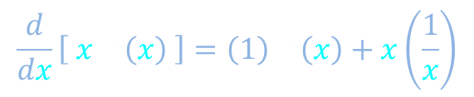
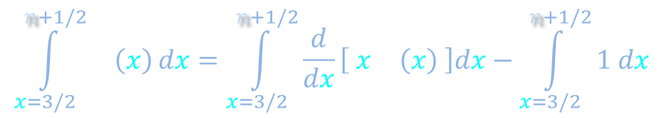


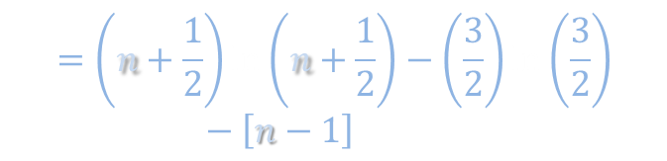
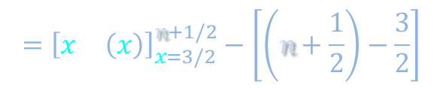
Stirling’s approximation
$$\ln\left( n! \right)=\ln\left[ n \left(n−1\right) \left(n−2\right) ⋯3 ∙2 ∙1 \right]$$
0
$$=\ln\left(n\right)∙1+\ln\left(n−1\right)∙1+\ln\left(n−2\right)∙1+⋯+\ln\left(3\right)∙1+\ln\left(2\right)∙1+\ln\left(1\right)$$
$$\ln\left( n! \right)≅\int_{x=3/2}^{n+1/2}{\ln\left(x\right)dx}$$
What derivative produces a natural log?
$$\frac{d}{dx}\left[ x\ln\left(x\right) \right]=\left(1\right)\ln\left(x\right)+x\left(\frac{1}{x}\right)$$
$$\int_{x=3/2}^{n+1/2}{\ln\left(x\right)dx}=\int_{x=3/2}^{n+1/2}{\frac{d}{dx}\left[ x\ln\left(x\right) \right]dx}−\int_{x=3/2}^{n+1/2}{1 dx}$$
$$={\left[x\ln\left(x\right)\right]}_{x=3/2}^{n+1/2}−\left[\left(n+\frac{1}{2}\right)−\frac{3}{2}\right]$$
$$\ln\left(x\right)$$
$$=\left(n+\frac{1}{2}\right)\ln\left(n+\frac{1}{2}\right)−\left(\frac{3}{2}\right)\ln\left(\frac{3}{2}\right)−\left[n−1\right]$$
n + 1/2
$$x$$
3/2

Slide 5
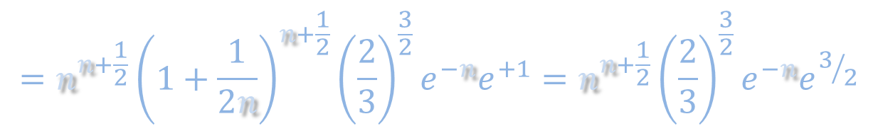

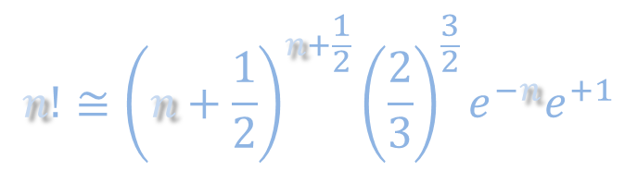

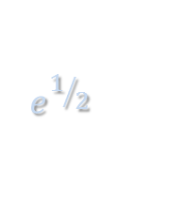

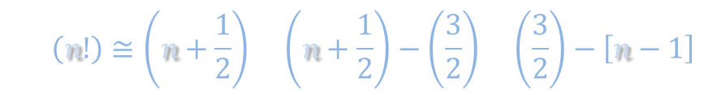


Stirling’s approximation
$$\ln\left(n!\right)≅\left(n+\frac{1}{2}\right)\ln\left(n+\frac{1}{2}\right)−\left(\frac{3}{2}\right)\ln\left(\frac{3}{2}\right)−\left[n−1\right]$$
$$n!≅{\left(n+\frac{1}{2}\right)}^{n+\frac{1}{2}}{\left(\frac{2}{3}\right)}^{\frac{3}{2}}e^{−n}e^{+1}$$
$$=n^{n+\frac{1}{2}}{\left(1+\frac{1}{2n}\right)}^{n+\frac{1}{2}}{\left(\frac{2}{3}\right)}^{\frac{3}{2}}e^{−n}e^{+1}=n^{n+\frac{1}{2}}{\left(\frac{2}{3}\right)}^{\frac{3}{2}}e^{−n}e^{3/2}$$
$${\left(1+\frac{1}{2n}\right)}^{n}$$
$${\left(1+\frac{1}{2n}\right)}^{\frac{1}{2}}$$
$$=\sqrt{{\left(\frac{2e}{3}\right)}^{3}}\sqrt{n} n^{n}e^{−n}$$
$$≈1$$
$$\ln\left(x\right)$$
$$e^{1/2}$$
2.44
2.51
$$n!≅\sqrt{2πn} n^{n} e^{−n}$$
n + 1/2
$$x$$
3/2

